Slide 1
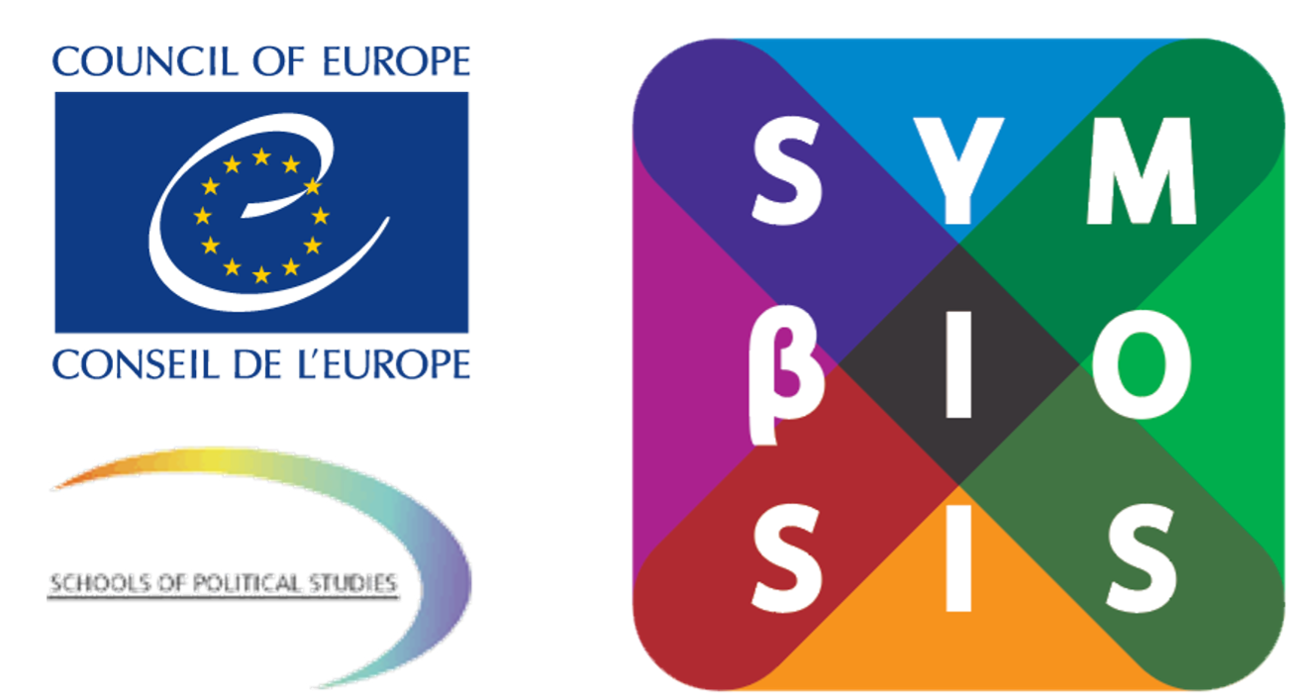
“Information Disorder: Understanding propaganda techniques during a war infodemic”

Slide 2
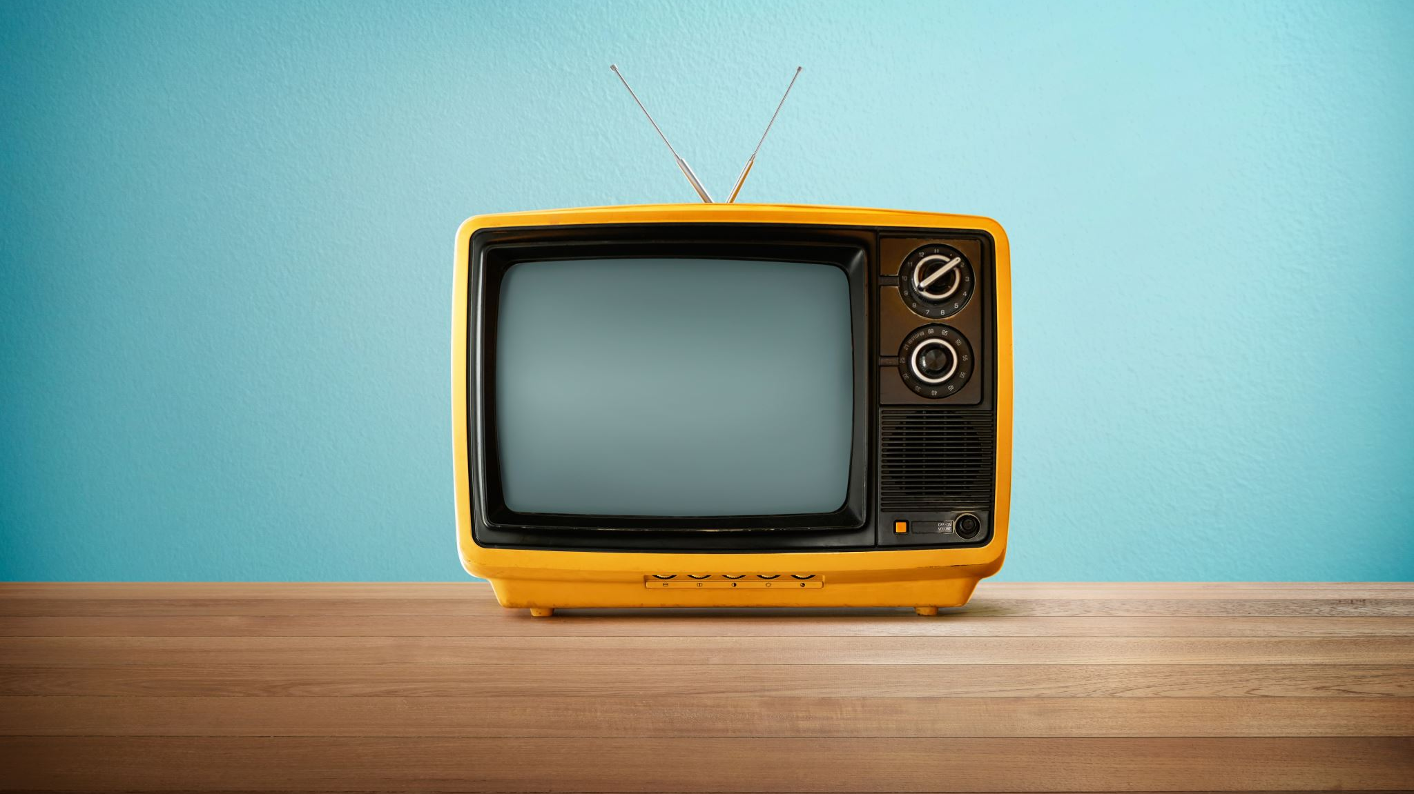
Old & New Media
From Consumer to Prosumer

Slide 3
Brief History of the Media

Slide 4
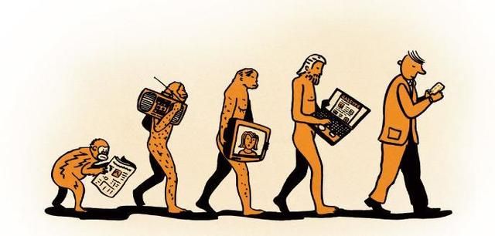
Old & New Media definition
What is Traditional Media?
Any form of mass communication available before the advent of digital media. This includes television, radio, newspapers, books, and magazines. (Encyclopaedia of Mobile Phone Behavior, 2015)
What is New Media?
The New Media Institute defines new media as “a catchall term used to define all that is related to the internet and the interplay between technology, images and sound.” Examples are: websites; blogs; email; social media networks; music & television streaming services; virtual and augmented reality

Slide 5
Differences between traditional and new media

Slide 6
From Consumer to “Prosumer”
The older forms of media forced the audiences to be passive consumers of the content provided to them, in the sense that there was only so much that they could do.
The new forms of media allow the audiences to not only consume content, but also produce content.
Therefore, we’re becoming Prosumers: Producers + Consumers.
Earlier the audiences could only read or watch news.
Today they can produce news through blogs, social media or Citizen Journalism portals.

Slide 7
The Use of Multimedia
Print media for example, only uses text and still images. Electronic media uses a number of codes, still and moving images etc., but New Media (online medium) trumps both of these with its use of multimedia. Text, images, hyperlinks, videos..a single page online can make use all of it.

Slide 8
Multiplicity of Delivery Platforms
Unlike old media, new media can be delivered on flexible formats – smartphones, tablets, laptops, PC etc.

Slide 9
Interactivity
New media allows for greater interactivity among both producers & consumers- audiences can give instant feedback to reporters, news channels through their Facebook page, Twitter, etc; and consumers & consumers- through comment feeds, social media interactions.

Slide 10
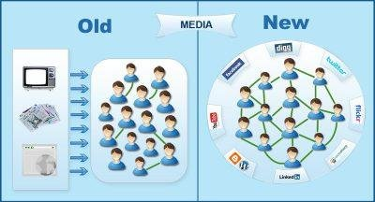
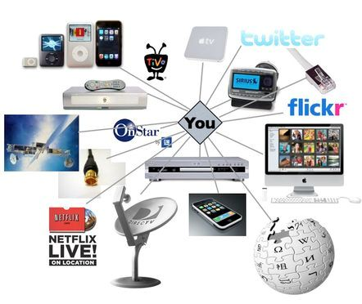
Scope and Reach
Newspaper circulation is bound to a certain physical space, and TV content, unless uploaded on the internet, remains within the viewership of their country’s audience. Therefore, older forms of media are limited in their scope and reach.
New media on the other hand, is far wider in it’s reach and scope. Once, anything goes on the net, it becomes accessible for almost anyone with a computer and net connection. However, questions of “digital divide” make this argument skeptical. A vast majority of the population still doesn’t have access to smart phones or the internet.
This increasing interactivity and greater scope of reach has eventually lead to the formation of a “Global Village” – an interconnected community that is not bound by space or borders. This is just taking forward the concept of “Imagined Communities”- a term that was coined by sociologist Benedict Anderson, who felt that people reading the same news in different parts of the country, far away from each other, felt connected, and part of the same community.
(Source: VSkills)

Slide 11
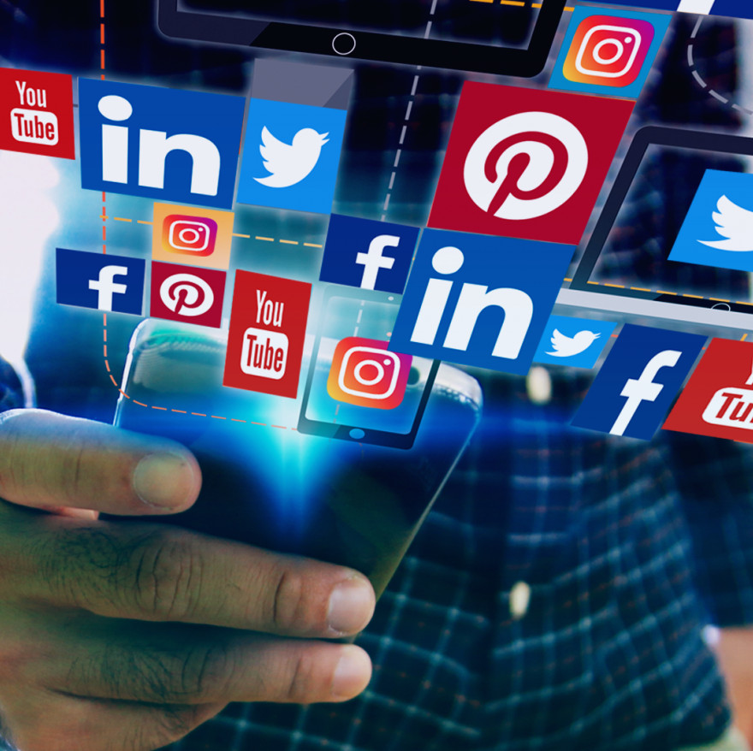
Social Media and News Consumption
The social media phenomenon began around 2003. Ever since more and more social media platforms appear, and the phenomenon is growing rapidly. The more popular social media websites are centered around a wall of information that is populated by friends and advertisers.
Facts
Social media is used to share information: The information can be truthful, un-truthful, or an opinion of the writer.
Social media has power to affect a social change on society: They allowed thousands of people to have a voice and spread the information that the user feels is relevant and important.
Information passed by social media can change the belief of an individual or a group.
Social media serve as providers of news worthy information to the user: Information appears based on the social media user friends sharing the information; or by who the user chooses to receive information from. Truthful or un-truthful information appears on the social media user news feed with or without consent of the user. (Source: Riddle, 2017)

Slide 12
Activity 1: What is Propaganda/Fake News/Information Disorder/Infodemic?
Ask participants to tell the first word that comes to their mind when they hear:
Propaganda
Fake News
Information Disorder
Infodemic
Create four ‘world clouds’ with participants’ answers. You can use www.mentimeter.com to create the ‘world clouds’ live online.
Reflect on the results aiming to understand what the level of awareness of participants regarding these issues is.

Slide 13
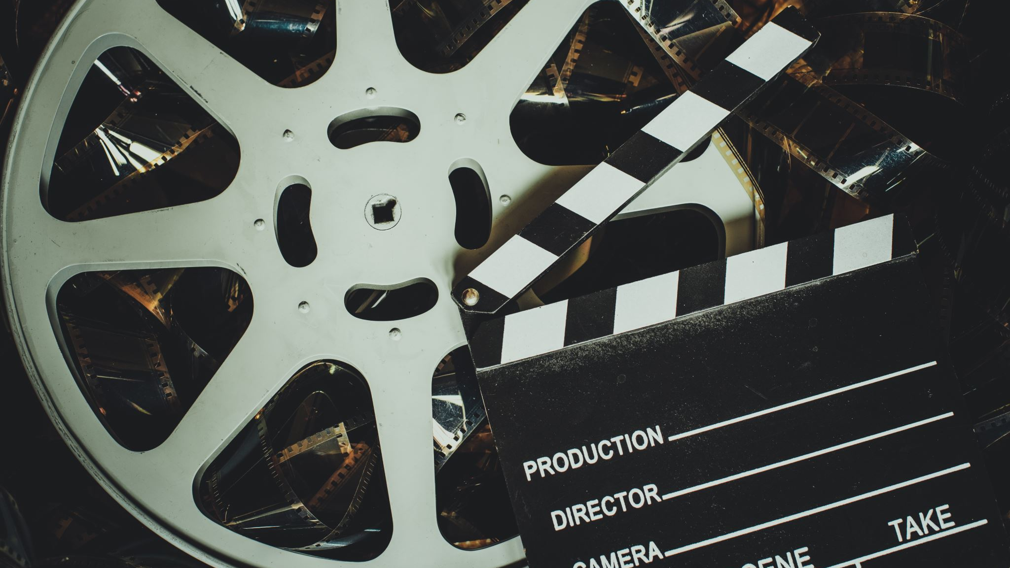
Storytelling through Media

Slide 14
Storytelling through Media: Creative documentary making
Storytelling techniques and tools
Personal story (self-discovery)
Character driven film/director driven film
Diary format

Slide 15
Creative Documentary project: ‘Greek wife’ - A work in progress
Human rights
Women rights
Emigration

Slide 16
Therapeutic effect of making video
Practising:
Freedom of expression
Communication
Anti-discrimination
Equality
Migration
Protection of the environment

Slide 17
Example 1

Slide 18
Example 2

Slide 19
Example 3

Slide 20
Telling your own story
Documenting your everyday life
Environment
Family
Feelings
Volunteering
Evacuation
Or just recordings of your family’s life in wartime

Slide 21
The Ukraine War Archive, Docudays UA
Collecting video and audio evidence of war
Evidence even from the cities which are currently under temporary occupation
Interviews with witnesses of war crimes and events
https://ukrainewararchive.org/

Slide 22
Links
DocudaysUA
http://docudays.ua/
Channel of resistance and aid from the Ukrainian film community
https://www.youtube.com/channel/UC__rBP4Gr_kZwlINAncM3Ag/about
#BABYLON'13
https://www.youtube.com/c/babylon13ua/featured

Slide 23
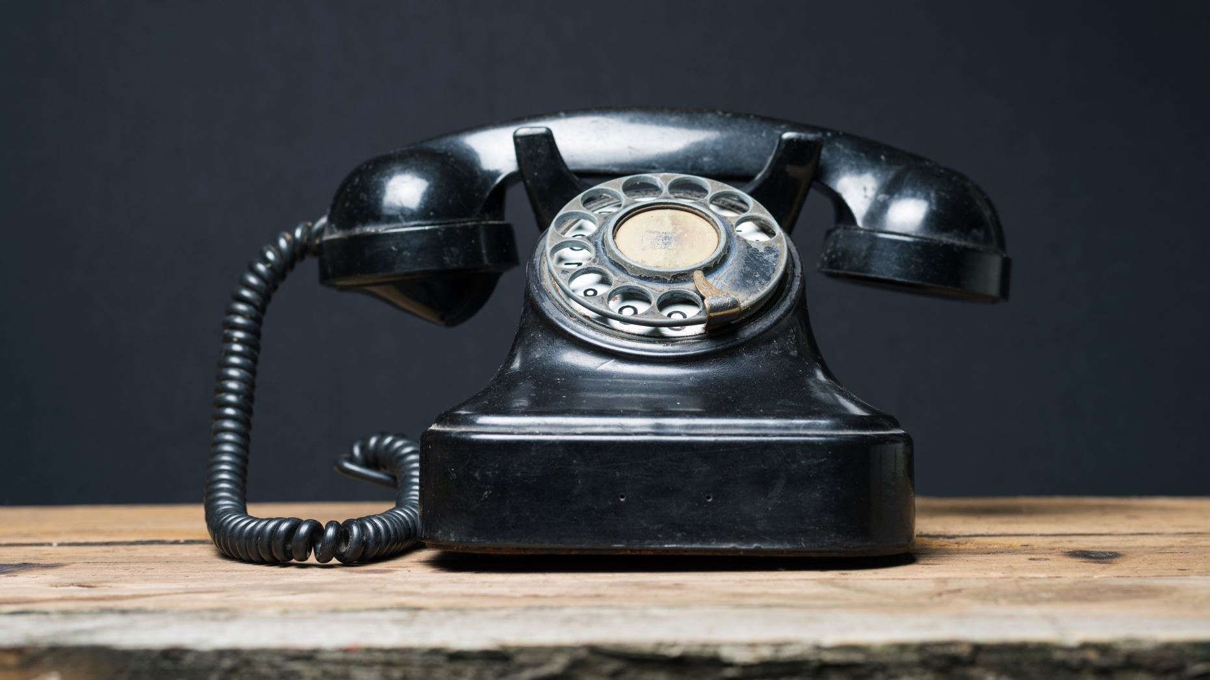
What is Mobile Phone Journalism

Slide 24
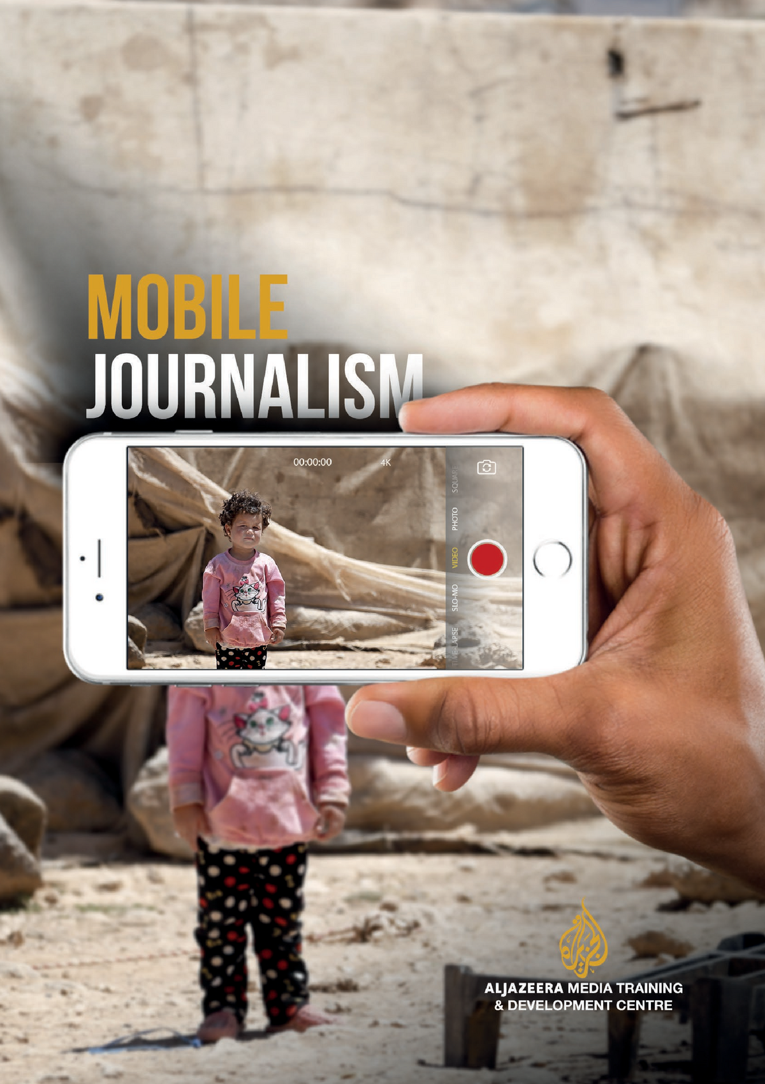
Mobile Phone Journalism
Mobile journalism follows the path already set by traditional journalism but only uses one device, a SMARTPHONE. The SMARTPHONE is used to bring together all the known forms of journalism by being used as the primary device to both CREATE and EDIT images as well as AUDIO and VIDEO.
Smartphones are now not only used for social media but they are also used in RADIO and TELEVISION, in making PODCASTS as well as in MAKING DOCUMENTARIES.

Slide 25
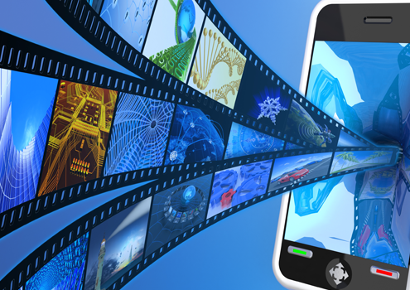
Your smartphone can really tell a story
Video production
Radio
Online and social media
Take photos
Create and publish podcasts
Phone your interviewees
Engage directly with your audience for feedback and follow-up stories.

Slide 26
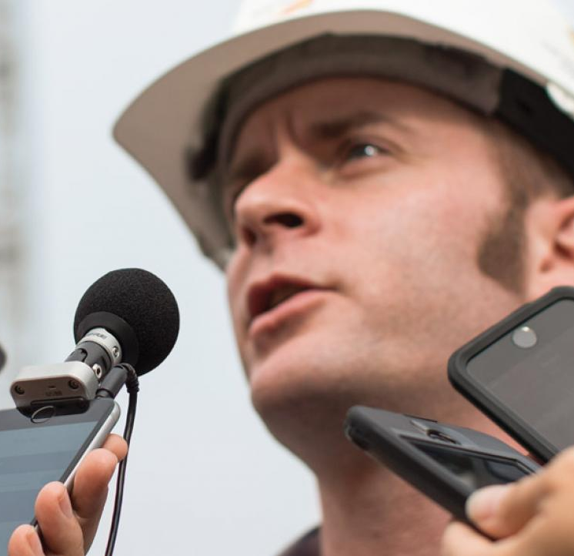
Benefits of MOJO
Affordable: You can achieve TV-quality video without needing many or any extras.
Portable: Even with the additional equipment - a lightweight tripod, clip-microphones and an external light can weigh under 3kg - most mobile journalists can fit their equipment in a backpack.
Discreet: An excellent tool for journalists who want to go unnoticed..
Approachable: We are all familiar with smartphones and find them less intimidating than TV cameras; the interviewee becomes more relaxed and opens up.
Apps for beginners to professionals: Dozens of apps – targeting both amateurs and professionals - make it easy for all to tell a story.

Slide 27
Thank you!

