Slide 1
“Information Disorder: Understanding propaganda techniques during a war infodemic”

Slide 2
The Psychology of Processing Information

Slide 3
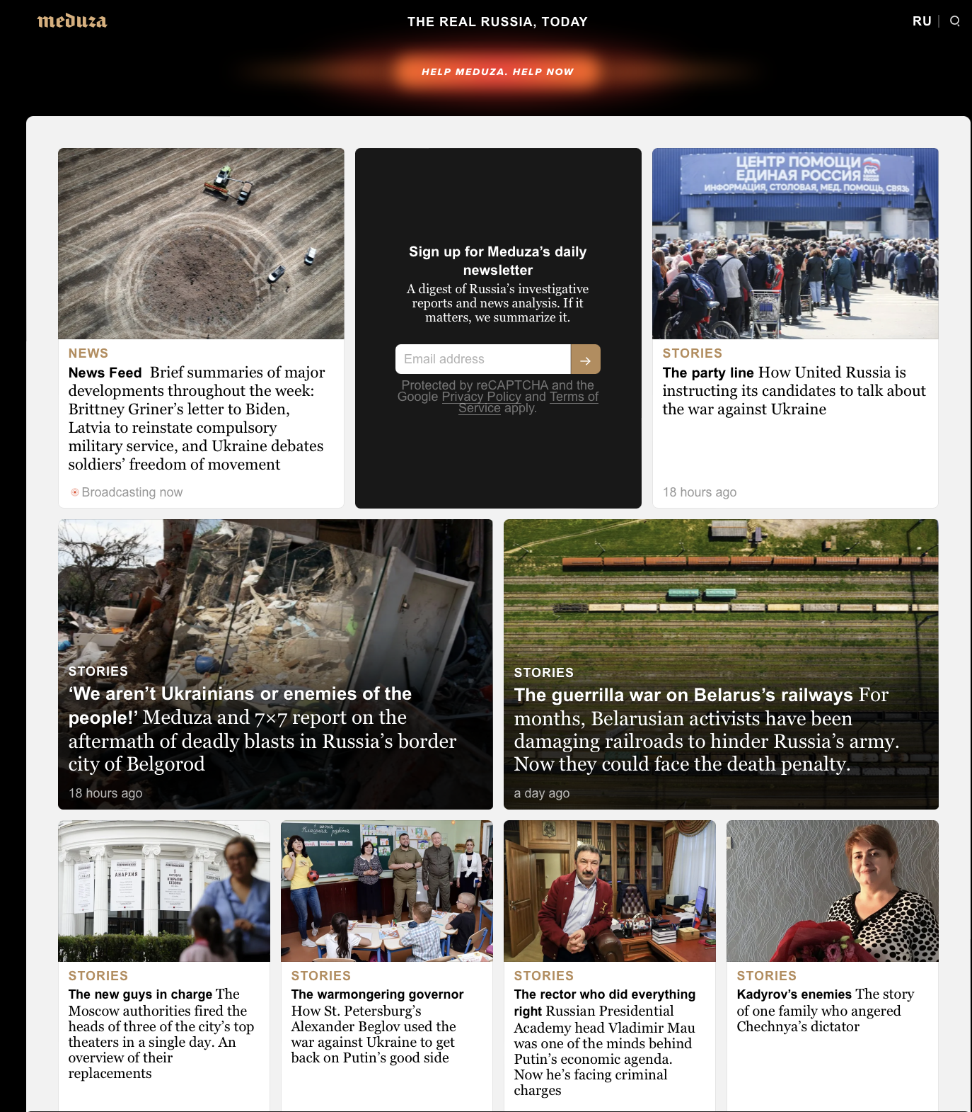
RUSSIA TODAY

Slide 4
How to detect bias in the news
Bias through selection and omission
An editor can express a bias by choosing to use or not to use a specific news item. This has a significant impact on what audiences think is important. Within any given story, some details can be ignored, and other included, to give readers a different opinion about the events reported. The biggest bias is always towards what journalists see as being “newsworthy” – but this question is always political, even if it isn’t seen that way.
Bias through placement
Readers judge first-page-stories to be more significant that those buried in the back. What section a story appears in matters too. Bias through placement can also happen when a story is placed near something else. Putting a news story next to an opinion article on the same topic, changes how we read it. How the story is organized is also significant (e.g. inverted pyramid style).
Bias by headline
Many people read only the headlines of a news item. Headlines can summarise as well as present carefully hidden bias and prejudices. They can express approval or condemnation. Even when a story avoids significant bias, because headlines are shorter they often give a much simpler and more biased picture.
Bias by photos, captions and camera angles
The selected audiovisual material accompanying a news item are also potential sources of bias.
Bias by word choice
What words are used to in a story has a major effect on how we read it, e.g., metaphors that provoke emotional reactions, passive voice, the selection of action verbs, the way a person or a group is described.
Bias by source and quote
Always consider where the news item “comes from”. In social media, “source hacking” manipulates treading topics or creates a fake controversy. You should always consider who is quoted. It’s important to look past a single story: most news outlets quote men more often than women overall, and white people more than non-white people.
Bias through false balance
It’s important for news articles to give both sides of a story.
Bias through statistics
Many news stories include statistics where can be bias in which statistics are included and how these statistics are interpreted.
(adapted from Newskit: A Consumers Guide to News Media)

Slide 5
Identifying the Actors

Slide 6
Info Disorder: Three elements in understanding it
Figure 1: Questions to ask about each element of an example of information disorder (Claire Wardle, First Draft, 2017).

Slide 7
Agent: Who were the ‘agents’ that created, produced and distributed the example, and what was their motivation?
Agents are involved in all three phases of the information chain – creation, production and distribution – and have various motivations. Importantly, the characteristics of agents can vary from phase to phase. We suggest seven questions to ask about an agent:
What type of actor are they? Agents can be official, like intelligence services, political parties, and news organizations. They can also be unofficial, like groups of citizens that have become evangelized about.
How organized are they? Agents can work individually, in longstanding, tightly-organized organizations (e.g., PR firms or lobbying groups) or in impromptu groups organized around common interests.
What are their motivations? There are four potential motivating factors: political, financial, social and psychological
Which audiences to they intend to reach? Different agents might have different audiences in mind. These audiences can vary from an organization’s internal mailing lists or consumers, to social groups based on socioeconomic characteristics, to an entire society.
Is the agent using automated technology?
Do they intend to mislead? The agent may or may not intend to deliberately mislead the target audience.
Do they intend to harm? The agent may or may not intend deliberately to cause harm.

Slide 8
Motivations: Four potential motivating factors for creating dis-information
Financial: Profiting from information disorder through advertising. Some of those who produce or distribute dis-information may do so merely for financial gain, as in the case of PR firms and fabricated news outlets.
Political: Discrediting a political candidate in an election and other attempts to influence public opinion. East StratCom Task Force explains that “the dis-information campaign is a non-military measure for achieving political goals.
Social: Connecting with a certain group online or off.
Psychological: Seeking prestige or reinforcement.

Slide 9
Message: What type of message was it? What format did it take? What were the characteristics?
How durable is the message? Some messages are designed to stay relevant and impactful for the long term (throughout an entire war or in perpetuity). Others are designed for the short term (during an election) or just one moment, as in the case of an individual message during a breaking news event.
How accurate is the message? The accuracy of a message is also important to examine. As discussed earlier, mal-information is truthful information used to harm (either by moving private information into the public arena or using people’s affiliations, like their religion, against them). For inaccurate information, there is a scale of accuracy from false connection (a click-bait headline that is mismatched with its article’s content) to 100% fabricated information.
Is the message legal? The message might be illegal, as in the cases of recognized hate speech, intellectual property violations, privacy infringements or harassment. Of course, what messages are legal differs by jurisdiction.
Is the message ‘imposter content’, i.e. posing as an official source? The message may use official branding (e.g., logos) unofficially, or it may steal the name or image of an individual (e.g., a well-known journalist) in order to appear credible.
What is the message’s intended target? The agent has an intended audience in mind (the audience they want to influence) but this is different to the target of the message (those who are being discredited). The target can be an individual (a candidate or a political or business leader), an organisation (a private firm or a government agency), a social group (a race, ethnicity, the elite, etc.) or an entire society.
The Appealing Message: Four Characteristics
It provokes an emotional response.
It has a powerful visual component.
It has a strong narrative.
It is repeated.

Slide 10
Interpreter. When the message was received by someone, how did they interpret the message? What action, if any, did they take?
An ‘audience’ is made up of many individuals, each of which interprets information according to his or her own socio-cultural status, political positions and personal experiences.
The types of information we consume, and the ways in which we make sense of them, are significantly impacted by our self-identity and the ‘tribes’ we associate with.
In a world where what we like, comment on and share is visible to our friends, family and colleagues, these 'social' and performative forces are more powerful than ever.
Evidence suggests that fact-checks do tend to nudge individuals’ knowledge in the direction of the correct information, but it certainly doesn’t replace the mis- or dis-information entirely.
What the ‘interpreter’ can do with a message highlights how the three elements of information disorder should be considered parts of a potential never-ending cycle.

Slide 11
Credibility of a message or a source
Reputation: Based on recognition and familiarity.
Endorsement: Whether others find it credible.
Consistency: Whether the message is echoed by multiple sites.
Expectancy violation: Whether a website looks and behaves in the expected manner.
Self-confirmation: Whether a message confirms one’s beliefs.
Persuasive intent: The intent of the source in creating the message.

